Slide 1
Digital Portfolio
STUDENT NAME: Vijisree. P
REGISTER NO AND NMID: 7ACC00F5A4B6294AC2A4EB5A294206F3
DEPARTMENT: BCA
COLLEGE: Sri Akilandeswari Women's college/ Thiruvalluvar University

Slide 2

PROJECT TITLE
Entrepreneur Portfolio - Healthy Eats Restuarant

Slide 3


AGENDA
Problem Statement
Project Overview
End Users
Tools and Technologies
Portfolio design and Layout
Features and Functionality
Results and Screenshots
Conclusion
Github Link
3/21/2024 Annual Review

Slide 4
PROBLEM STATEMENT
Many people lack access to healthy and hygienic food options when dining out.
Traditional restaurants often overlook nutrition and cleanliness.
There's also a need for entrepreneurs to showcase their food ventures professionally.
This project solves both by presenting Healthy Eats through a digital portfolio that highlights its health -focused mission and growth.

Slide 5

PROJECT OVERVIEW
This project is a digital Portfolio showcasing my journey as an entrepreneur and founder of Healthy Eats, a restuarant committed to providing healthy, hygienic, and nutritious meals.
The portfolio highlights my background, business concept, operational strategies, key skills, and future vision.

Slide 6

WHO ARE THE END USERS?
Health-conscious customers looking for clean and nutritious dining options.
Potential investors or business partners interested in restaurant expansion.
Franchise seekers exploring healthy food business models.
Job seekers interested in joining a health-focused restaurant team.

Slide 7

TOOLS AND TECHNIQUES
HTML & CSS - for building the structure and styling the website.
Responsive Web Design - for compatibility across devices.
Basic SEO techniques - to ensure online visibility.
Visual hierarchy and branding - for clear, appealing presentation.

Slide 8
PORTFOLIO DESIGN AND LAYOUT
The portfolio is designed using HTML and CSS. The layout is structured into clear sections such as:
Header - with name, title, brand introduction
About me - brief personal & business background
Restaurant overview - key facts and achievements
My Role - responsibilities & contribution as entrepreneur
Skills - highlighting core business & leadership abilities
Vision - outlining future plans for growth
contact - with links to email, social media and website
8

Slide 9
FEATURES AND FUNCTIONALITY
Responsive Design - works smoothly on both desktop and mobile devices.
Clean Navigation - clear, section-wise layout for easy user experience.
Contact Integration - include clickable links for email, instagram and website.
Business Highlights - showcases key achievements, services and customer reach.
Future Vision - communicates goals such as expansion and franchising.

Slide 10
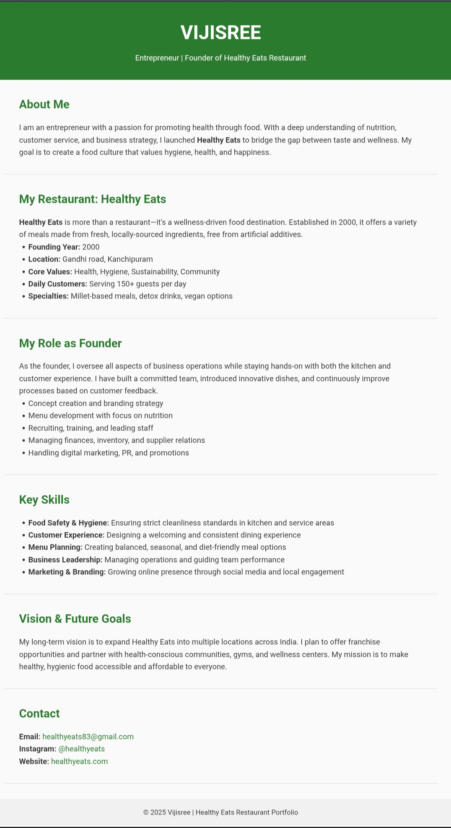

RESULTS AND SCREENSHOTS
3/21/2024 Annual Review
10

Slide 11
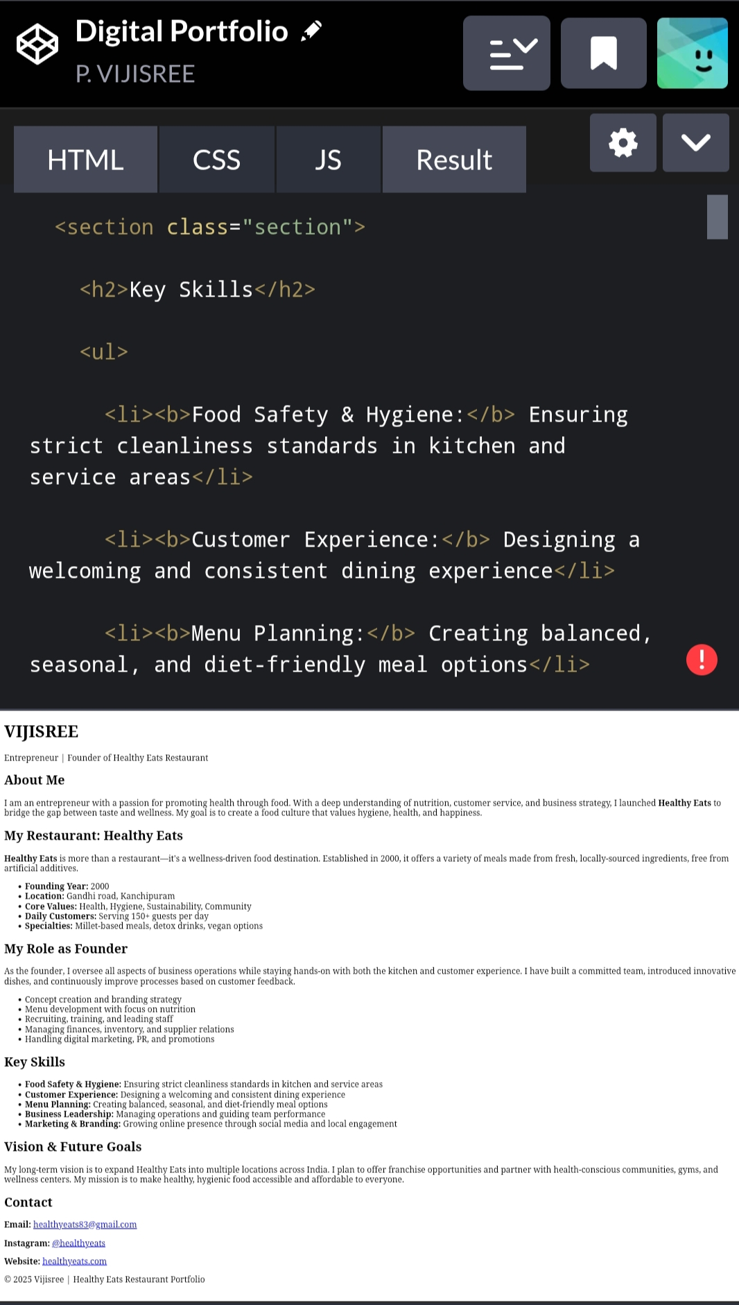
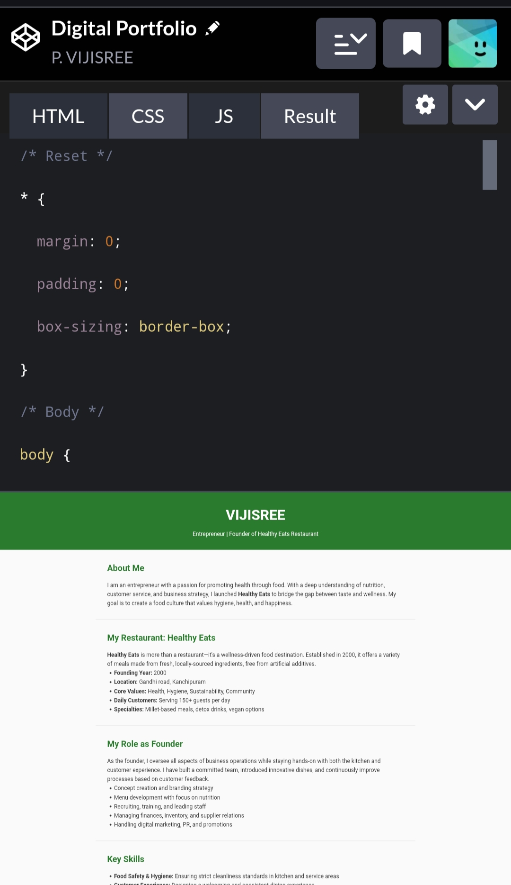
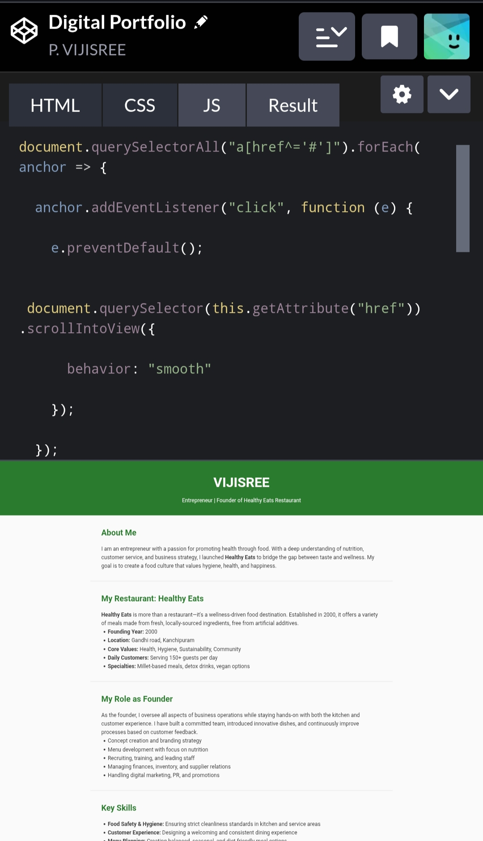

Slide 12
CONCLUSION
This portfolio highlights my journey as the founder of Healthy Eats, showcasing my focus on healthy, hygienic food and strong business values.
It helps build my professional identity and opens doors for future growth and opportunities.
It supports society by encouraging healthy eating, hygiene and sustainable food practices.
12

